Slide 1
CSS - Training

Slide 2
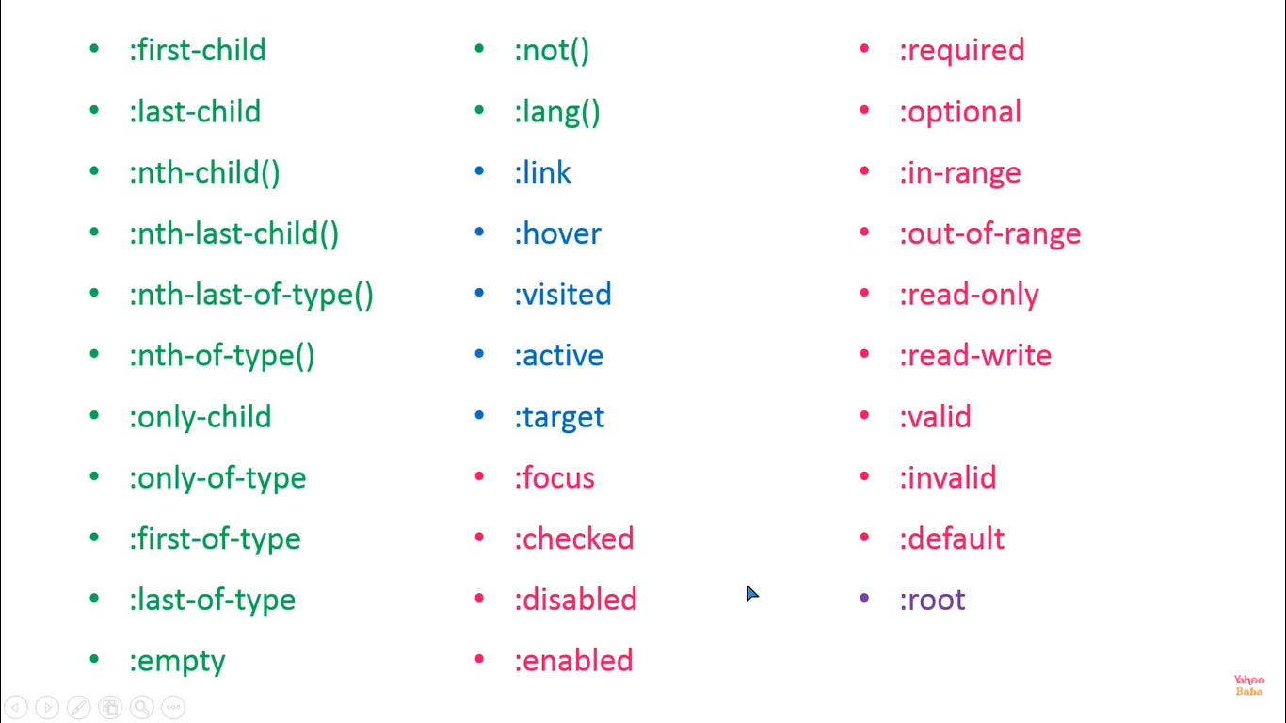
Pseudo Classes

Slide 3

PseudoClass:first-child

Slide 4
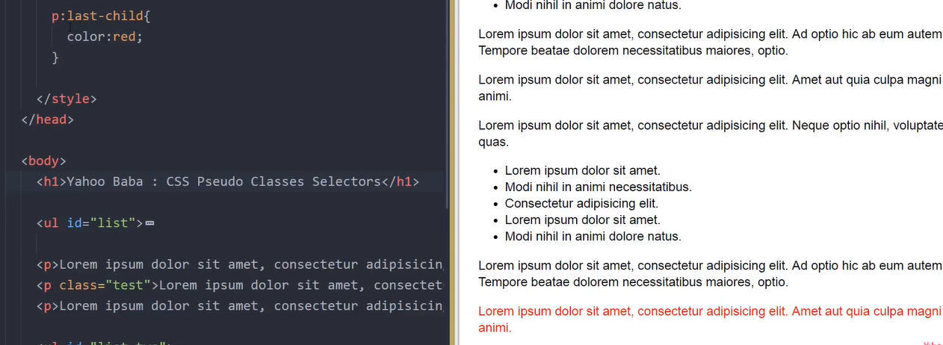
PseudoClass:last-child

Slide 5
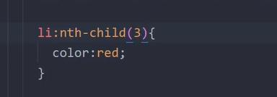
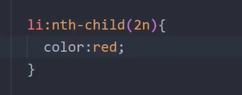
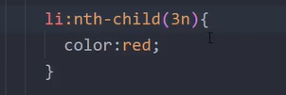
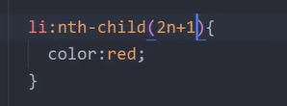
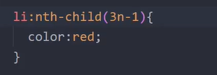
PseudoClass:nth-child()-to target element in sequence

Slide 6


PseudoClass:nth-last-child()-to target element from last in sequence

Slide 7
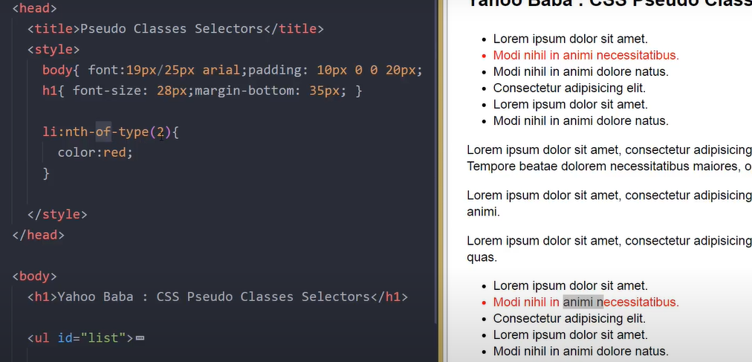
PseudoClass: nth-of-type() – any type but it will concentrate on particular element

Slide 8
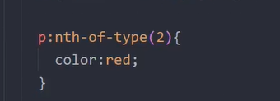

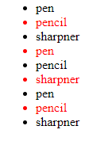
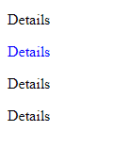
PseudoClass: nth-of-type() – without child as well it will target

Slide 9
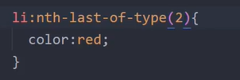

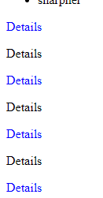
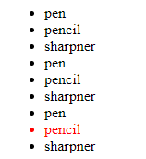
PseudoClass: nth-last-of-type() – without child as well it will target

Slide 10
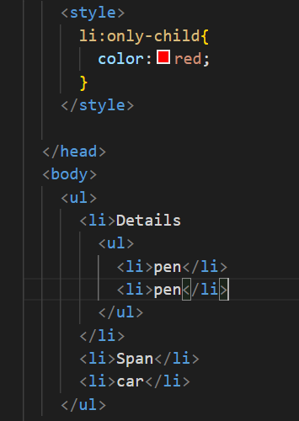
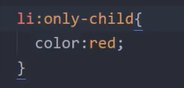
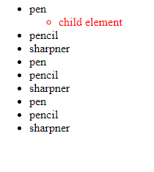
PseudoClass: only-child() - only that particular child only (only one child)

Slide 11
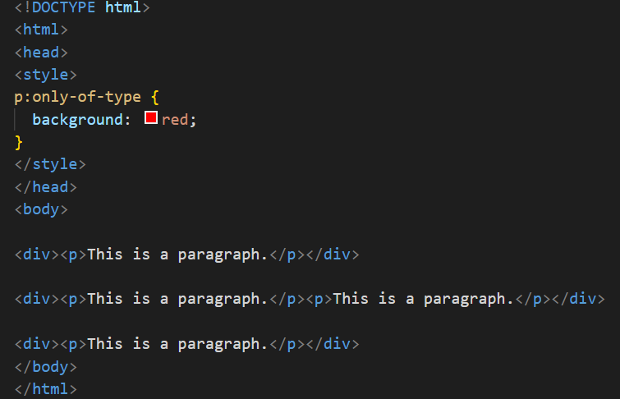
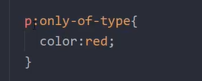

PseudoClass: only-of-type()- only that particular tag one time is there but other tag we can have it

Slide 12
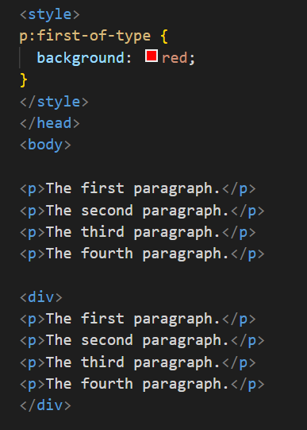

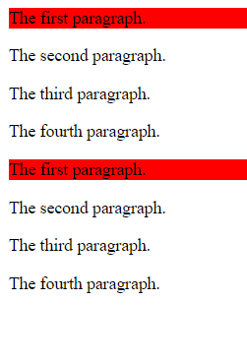
PseudoClass: first-of-type()-it will select first element with or without parent

Slide 13
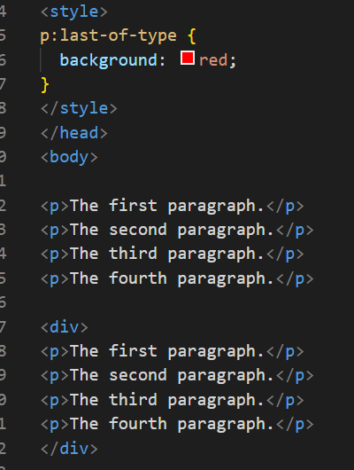
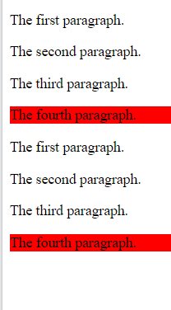
PseudoClass: last-of-type()-it will select last element with or without parent

Slide 14
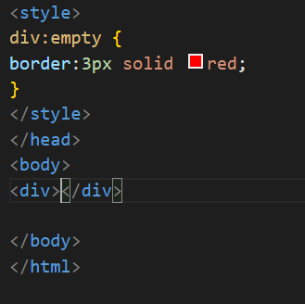

PseudoClass: empty – any empty tag without content without white space

Slide 15
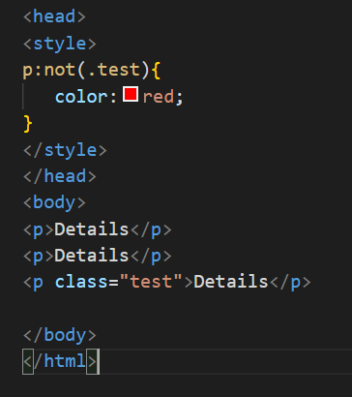
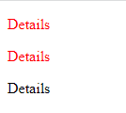
PseudoClass: not()- excepting that paritcular element

Slide 16
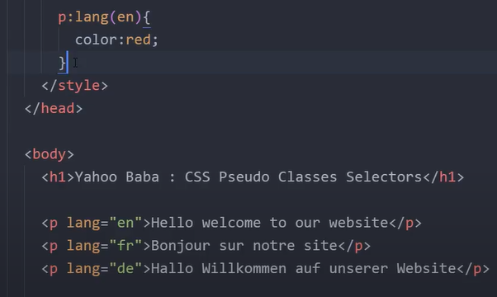
PseudoClass: lang()-targeting particular language

